Slide 1


Christopher Chan

Slide 2

Outline
Executive Summary
Introduction
Methodology
Results
Conclusion
Appendix

Slide 3
Executive Summary
This capstone project is to determine if SpaceX’s Falcon 9 launch will successfully land using different machine learning models.
The methodology to acquire, clean, and analyze data is as follows: Data collection (API & Webscraping), Data wrangling (pandas), Exploratory data analysis (SQL and pandas), Data visualization (plotly, folium, and seaborn), and Machine Learning (pandas and sklearn)
There were several features that was correlated to the success of a rocket launch, these features were used during modeling
Based on confusion matrix and score analysis of the different ML models, we conclude that the best model is decision tree with an accuracy of 0.89
Notes:
Summary of methodologies
Summary of all results

Slide 4
Introduction
The goal of the capstone project is to determine if Falcon 9 launch will be successful. The inspiration behind this project is the ability to reuse the rocket after launch, which will save operating cost and enable rocket reusability. We can significantly reduce the cost of SpaceX by helping them predict the success rate of their rocket launches.
The problem we hope to answer with our analysis is whether Falcon 9 launch will be successful based on several features
Notes:
Project background and context
Problems you want to find answers

Slide 5

Section 1

Slide 6
Executive Summary
Data was collected through requesting data from SpaceX API and webscraping launch data. The data sets were cleaned and transformed using pandas. After cleaning the data, exploratory data analysis was carried out using python data analysis (pandas) visualization (seaborn, plotly dash, and folium) libraries and SQL to grasp a better understanding of the dataset.
Logistic regression, support vector machine, decision tree, and k-nearest neighbor models were used for predicative analysis. Each model was trained using the same training and testing dataset and optimized using GridSearchCV. The accuracy of each model was determined using a confusion matrix and score function
Notes:
Executive Summary
Data collection methodology:
Describe how data was collected
Perform data wrangling
Describe how data was processed
Perform exploratory data analysis (EDA) using visualization and SQL
Perform interactive visual analytics using Folium and Plotly Dash
Perform predictive analysis using classification models
How to build, tune, evaluate classification models

Slide 7
Summary
1
API
2
3
4
Webscraping
Data Wrangling
EDA
5
Folium
6
Plotly Dash
7
Machine Learning Model Optimization
Notes:
Describe how data sets were collected.
You need to present your data collection process use key phrases and flowcharts

Slide 8
Data Collection – SpaceX API
1
Request SpaceX launch data using GET request
2
3
4
5
6
Normalize JSON response into a dataframe, data
Extract useful columns and move them to dictionary for new dataframe
Filter dataframe to include only Falcon 9 launches
Handle missing data
Export data to CSV file

Slide 9
Data Collection - Scraping
1
Request SpaceX launch data using GET request
2
3
4
Normalize JSON response into a dataframe, data
Extract useful columns and move them to dictionary for new dataframe
Filter dataframe to include only Falcon 9 launches

Slide 10
Data Wrangling
1
Calculate the number of launches on each launch site
2
3
4
5
Calculate the number and occurrence of each orbit
Calculate the number and occurrence of mission outcome per orbit type
Create a landing outcome label from Outcome column using replace
Export data to CSV file

Slide 11
EDA with Data Visualization
Scatterplot – Visualize the relationship between two features.
Flight Number and Payload
Flight Number and Launch Site
Payload and Launch Site
Flight Number and Orbit Type
Payload and Orbit Type
Bar graph – Visualize the relationship between different categorical groups
Orbit Type and Success Rate
Line plot – Visualize the trend of a variable over time
Years and Success Rate
Github link:

Slide 12
EDA with SQL
Performed various SQL queries to determine the following:
Types of landing outcomes
Total payload mass by NASA
Average payload mass by F9 booster
Successful launches with a specific payload (4000kg to 6000kg)
Boosters carrying the maximum payload
Successful launches between certain date range
SQL allows use to filter data and find useful information about the dataset
Github link:
Notes:
Using bullet point format, summarize the SQL queries you performed
Add the GitHub URL of your completed EDA with SQL notebook, as an external reference and peer-review purpose

Slide 13
Build an Interactive Map with Folium
Objects were created and added to the Folium map
Marker objects
Used to show launch sites
Number of success/failed launches
Line objects
Calculate the distance between launch site and geographical feature
Adding these objects allowed us to answer the following questions
Are launch sites in close proximity to railways? Yes
Are launch sites in close proximity to highways? Yes
Are launch sites in close proximity to coastline? Yes
Do launch sites keep certain distance away from cities? Yes
Github Link:
Notes:
Summarize what map objects such as markers, circles, lines, etc. you created and added to a folium map
Explain why you added those objects
Add the GitHub URL of your completed interactive map with Folium map, as an external reference and peer-review purpose

Slide 14
Build a Dashboard with Plotly Dash
The dashboard contains two visuals:
Pie Chart
Shows the percentage of successful launches from each site.
Visualize the success rate of each site to make appropriate insights
Scatterplot
Shows the relationship between landing outcome and payload mass
Filter booster type with dropdown
Slider allows user to see data of different payload ranges
Github link:
Notes:
Summarize what plots/graphs and interactions you have added to a dashboard
Explain why you added those plots and interactions
Add the GitHub URL of your completed Plotly Dash lab, as an external reference and peer-review purpose

Slide 15
Predictive Analysis (Classification)
1
Import data and create a label using ‘Class’ column
2
3
4
5
Preprocess feature dataset
Create train and test dataset
Determine the hyperparameter of different models (LogR, Tree, KNN, and SVM) using GridSearchCV
Determine accuracy of the different models
6
Plot the confusion matrix
Notes:
Summarize how you built, evaluated, improved, and found the best performing classification model
You need present your model development process using key phrases and flowchart
Add the GitHub URL of your completed predictive analysis lab, as an external reference and peer-review purpose

Slide 16
Results
From the EDA, the success rate of Falcon 9 landings were on average 66.6%
The predictive analysis shows that the Decision tree model was the most optimal model with an accuracy of 89% and good confusion matrix
Notes:
Exploratory data analysis results
Interactive analytics demo in screenshots
Predictive analysis results

Slide 17

Section 2

Slide 18
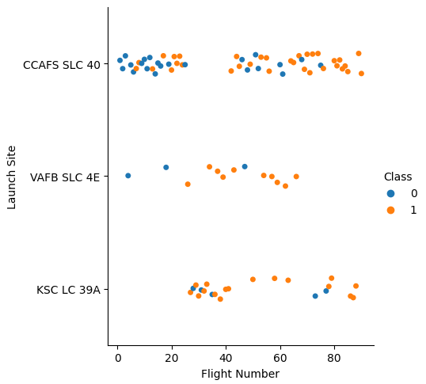
Flight Number vs. Launch Site
Show a scatter plot of Flight Number vs. Launch Site
Show the screenshot of the scatter plot with explanations

Slide 19
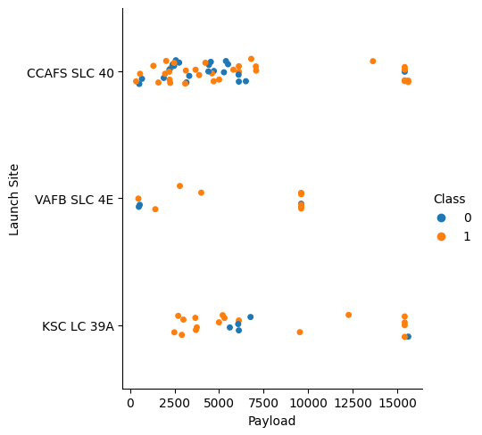
Payload vs. Launch Site
Show a scatter plot of Payload vs. Launch Site
Show the screenshot of the scatter plot with explanations

Slide 20
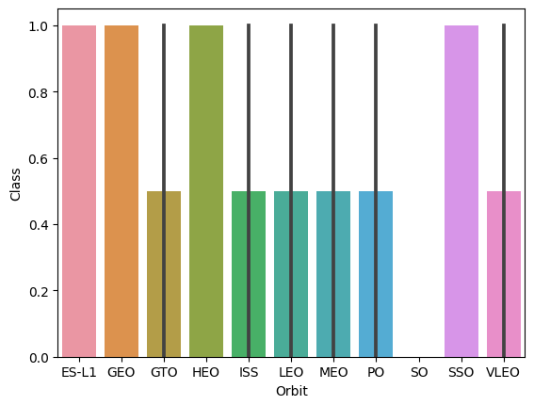
Success Rate vs. Orbit Type
Show a bar chart for the success rate of each orbit type
Show the screenshot of the scatter plot with explanations

Slide 21
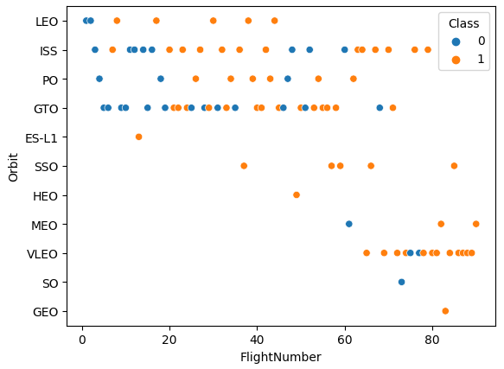
Flight Number vs. Orbit Type
Show a scatter point of Flight number vs. Orbit type
Show the screenshot of the scatter plot with explanations

Slide 22
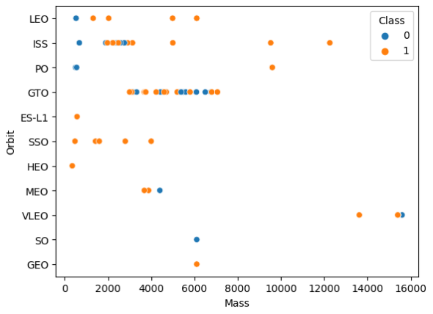
Payload vs. Orbit Type
Show a scatter point of payload vs. orbit type
Show the screenshot of the scatter plot with explanations

Slide 23
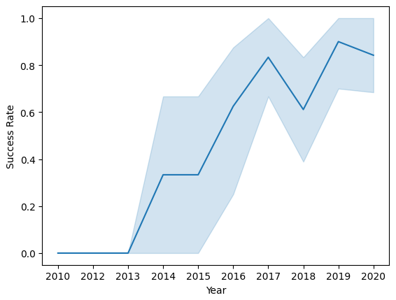
Launch Success Yearly Trend
Show a line chart of yearly average success rate
Show the screenshot of the scatter plot with explanations

Slide 24
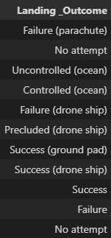
All Launch Site Names
Find the names of the unique launch sites
Present your query result with a short explanation here

Slide 25
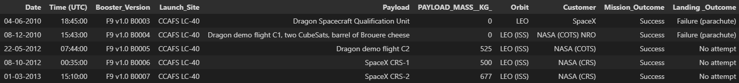
Launch Site Names Begin with 'CCA'
Find 5 records where launch sites begin with `CCA`
Present your query result with a short explanation here

Slide 26
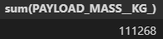
Total Payload Mass
Calculate the total payload carried by boosters from NASA
Present your query result with a short explanation here

Slide 27
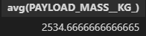
Average Payload Mass by F9 v1.1
Calculate the average payload mass carried by booster version F9 v1.1
Present your query result with a short explanation here

Slide 28
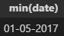
First Successful Ground Landing Date
Find the dates of the first successful landing outcome on ground pad
Present your query result with a short explanation here

Slide 29
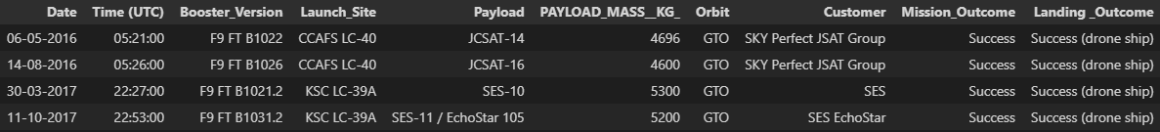
Successful Drone Ship Landing with Payload between 4000 and 6000
List the names of boosters which have successfully landed on drone ship and had payload mass greater than 4000 but less than 6000
Present your query result with a short explanation here

Slide 30
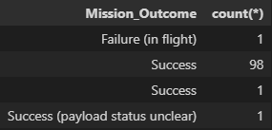
Total Number of Successful and Failure Mission Outcomes
Calculate the total number of successful and failure mission outcomes
Present your query result with a short explanation here

Slide 31
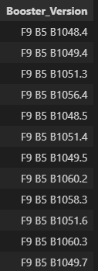
Boosters Carried Maximum Payload
List the names of the booster which have carried the maximum payload mass
Present your query result with a short explanation here

Slide 32
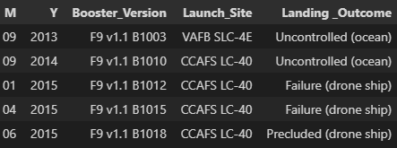
2015 Launch Records
List the failed landing_outcomes in drone ship, their booster versions, and launch site names for in year 2015
Present your query result with a short explanation here

Slide 33
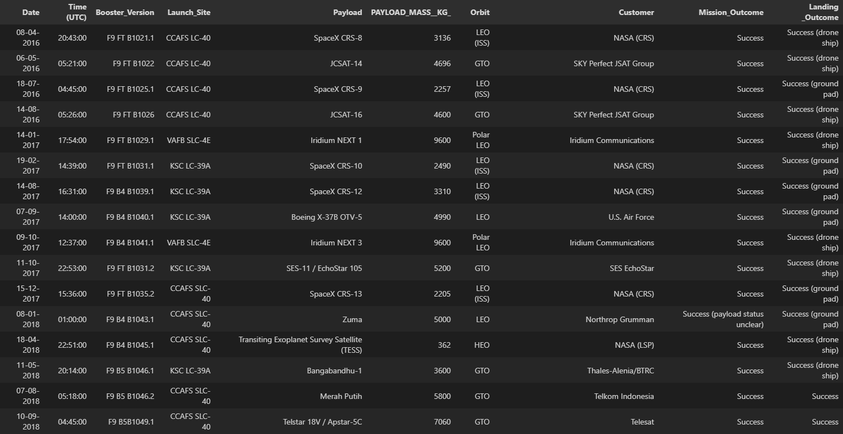
Rank Landing Outcomes Between 2010-06-04 and 2017-03-20
Rank the count of landing outcomes (such as Failure (drone ship) or Success (ground pad)) between the date 2010-06-04 and 2017-03-20, in descending order
Present your query result with a short explanation here

Slide 34

Section 3

Slide 35
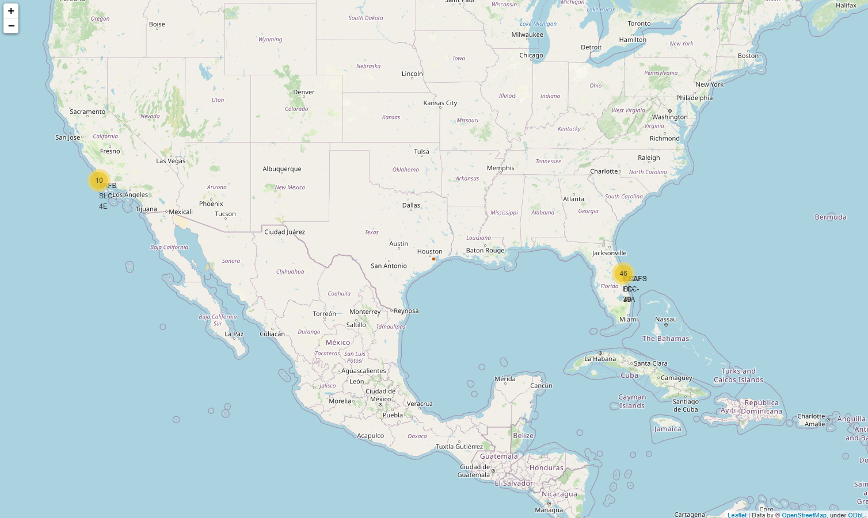
<Folium Map Screenshot 1>
Replace <Folium map screenshot 1> title with an appropriate title
Explore the generated folium map and make a proper screenshot to include all launch sites’ location markers on a global map
Explain the important elements and findings on the screenshot

Slide 36
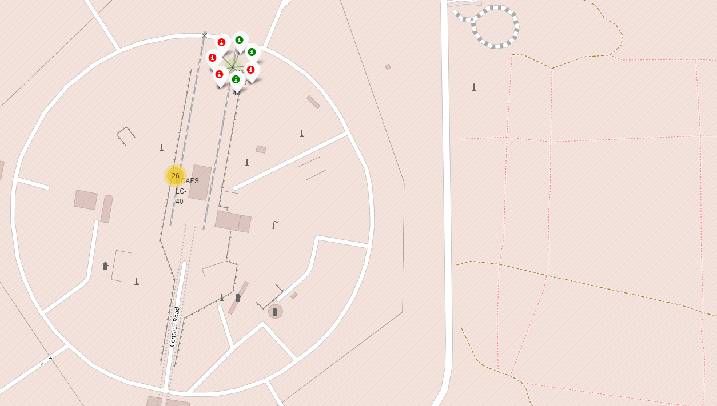
<Folium Map Screenshot 2>
Replace <Folium map screenshot 2> title with an appropriate title
Explore the folium map and make a proper screenshot to show the color-labeled launch outcomes on the map
Explain the important elements and findings on the screenshot

Slide 37
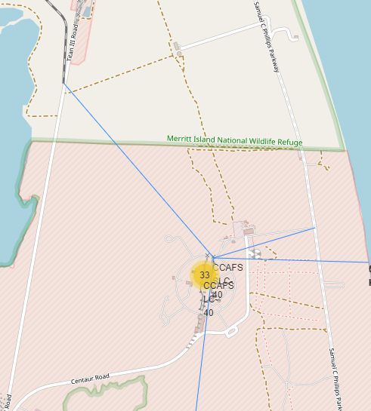
<Folium Map Screenshot 3>
Replace <Folium map screenshot 3> title with an appropriate title
Explore the generated folium map and show the screenshot of a selected launch site to its proximities such as railway, highway, coastline, with distance calculated and displayed
Explain the important elements and findings on the screenshot

Slide 38

Section 4

Slide 39
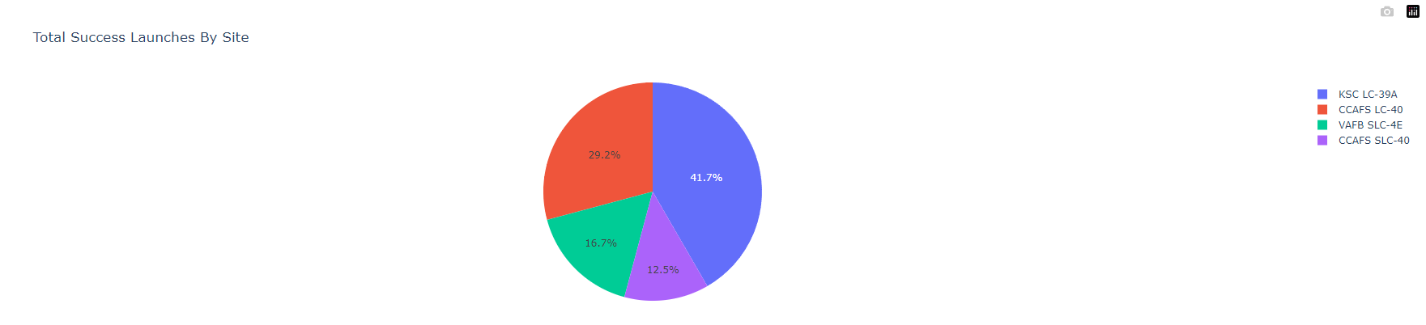
<Dashboard Screenshot 1>
Replace <Dashboard screenshot 1> title with an appropriate title
Show the screenshot of launch success count for all sites, in a piechart
Explain the important elements and findings on the screenshot

Slide 40
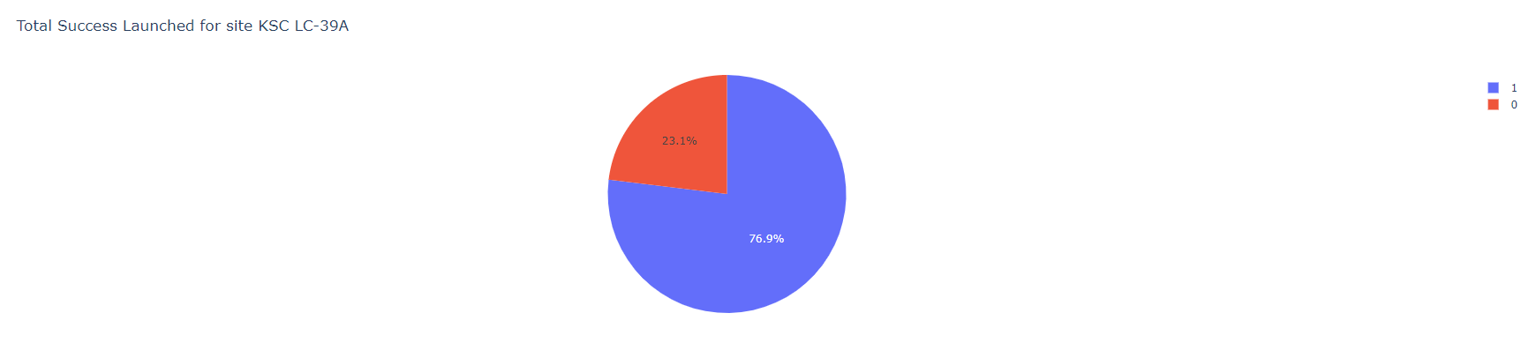
<Dashboard Screenshot 2>
Replace <Dashboard screenshot 2> title with an appropriate title
Show the screenshot of the piechart for the launch site with highest launch success ratio
Explain the important elements and findings on the screenshot

Slide 41
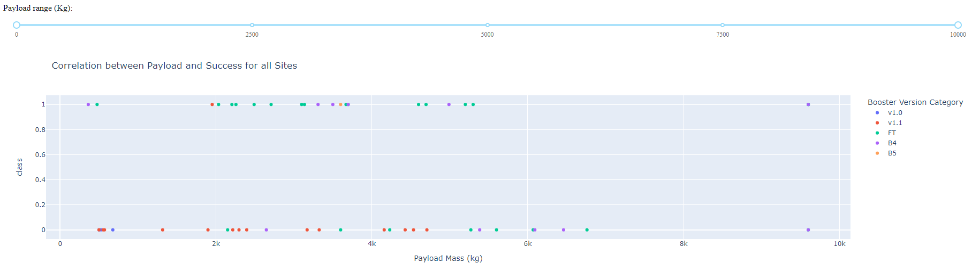
<Dashboard Screenshot 3>
Replace <Dashboard screenshot 3> title with an appropriate title
Show screenshots of Payload vs. Launch Outcome scatter plot for all sites, with different payload selected in the range slider
Explain the important elements and findings on the screenshot, such as which payload range or booster version have the largest success rate, etc.

Slide 42

Section 5

Slide 43
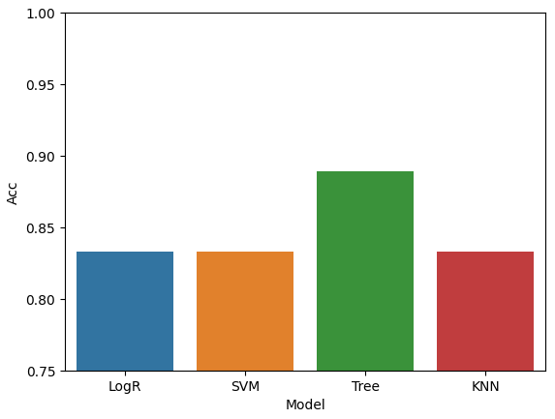
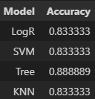
Classification Accuracy
Visualize the built model accuracy for all built classification models, in a bar chart
Find which model has the highest classification accuracy

Slide 44
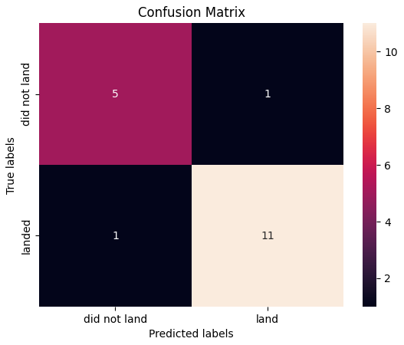
Confusion Matrix
Show the confusion matrix of the best performing model with an explanation

Slide 45
Conclusions
Point 1
Point 2
Point 3
Point 4
…

Slide 46
Appendix
Include any relevant assets like Python code snippets, SQL queries, charts, Notebook outputs, or data sets that you may have created during this project

Slide 47


